Slide 1
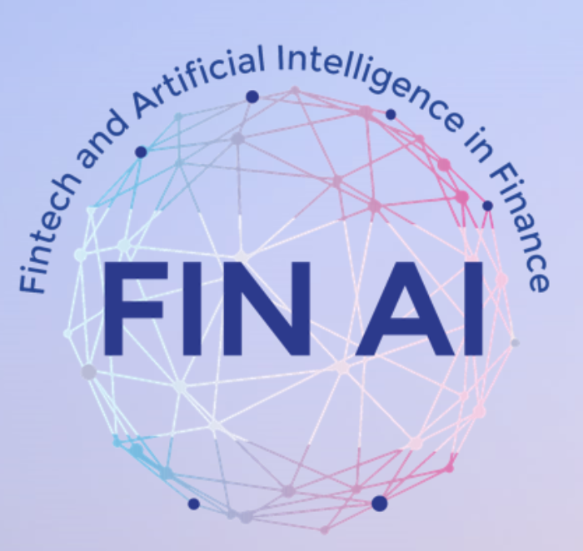
Portugal
Country Updates, 2024

Slide 2
FinAI – MC Committee
Bernardete Ribeiro, Joana Costa - MC
Catarina Silva, Luisa Morgado - MC Substitutes
University of Coimbra, University UTAD

Slide 3
Main Aims
Contribution Topics
Building network to conduct multidisciplinary research
Participation in joint data collection efforts
Participation in joint research proposal writing efforts
Providing mobility of doctoral students at other universities
WG2 – Transparent versus Black Box Decision-Support Models in the Financial Industry
WG3 – Transparency into Investment Product Performance for Clients

Slide 4
Line of research 1
We continued to extend LIME and SHAP to new scenarios
P. G. Silva, C. Silva and D. Gaspar, Explainable AI for Intrusion Detection Systems: LIME and SHAP Applicability on Multi-Layer Perceptron, IEEE ACCESS, 2024, DOI:10.1109/ACCESS.2024.3368377
Research Coordination 2:
The development of conceptual and methodological tools for establishing when black-box models are admissible and, to the extent possible, making them more transparent and/or replacing them with interpretable and explainable models.
Line of research 2
We explored a bibliometrc approach to analyse gender impact in research in transparency in Fintech
C. Silva, J. Dias, G. Leitão andd B. Ribeiro, A Bibliometric Analysis of Transparency AI in Fintech with Emphasis on Gender Dynamics (in preparation)

Slide 5
Participation on the meeting COST meets Istanbul, May 2024
Organization of COST meets Coimbra, July 2024
Capacity Building 1:
Create an excellent network of researchers in Europe with lasting collaboration beyond the lifetime of the Action.

Slide 6
Capacity Building 2 and 3:
Bringing technological, quantitative and economic researchers together, to tackle future research that can only be done in an interdisciplinary setting and getting actively involved in the blockchain and FinTech communities across Europe, to constantly monitor developments, get input and disseminate results.
Bridging the gap between practitioners from the finance industry, academics and regulators by setting up a common knowledge exchange platform.
Hosting Bekir ÇETİNTAV from Turkey in an STSM (cooperation with Branka Hadji Misheva, Codruta Mare and Alessandra Tanta to contribute to the study of the impact of transparency in LLMs.

Slide 7
STSM co-Coordination activities (Catarina Silva)
Work in progress with Bekir ÇETİNTAV considering the transparency in fintech industry
Organization of “COST meets Coimbra” July, 10-11 (Catarina Silva, Joana Dias, Bernardete Ribeiro)
Planned contribution to Springer volume
Activities in 2024

